Slide 1
DAY-USE HOTEL WEBSITE SCRAPING PROJECT
Group Members:
Nicholas
Hector
Shayan

Slide 2
Aim - What are we doing?
We are scraping a website for day-use bookings for various hotels in Hong Kong (https://en.dayuse.com.hk/)
The scraped information includes the hotel name, address, description, prices, district, discount offered, amenities, star information, review counts, ratings, etc.
We want to look at the quality and pricing of the various hotel deals offered.

Slide 3
Business Value - Why are we doing this?
As a customer:
Value for money
Maximize our hotel stay enjoyment
Find the most attractive deals
As a hotel owner:
Observe competitors
See what is most important in terms of bringing in customers
Maximize profits

Slide 4
Data Collection - Website, How (Web-scraping/API, libraries used)
Beautiful Soup with Selenium Chrome Driver for Web-scraping
Other libraries used:
Pandas
Numpy
Datetime
Regex
Matplotlib, Seaborn for data visualization.

Slide 5
Analysis
Exploratory Analysis
Market Trend
Price Trend
Location importance

Slide 6
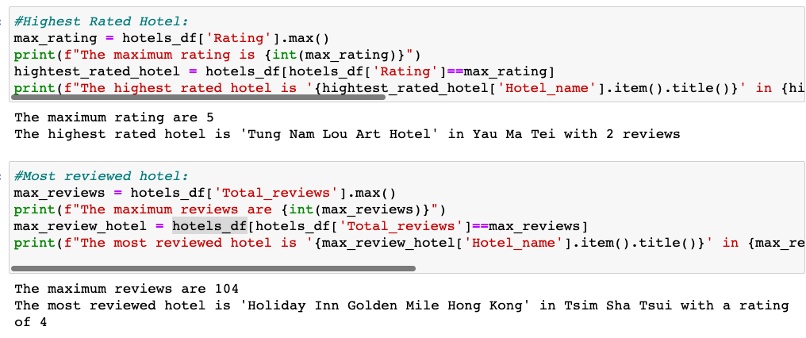
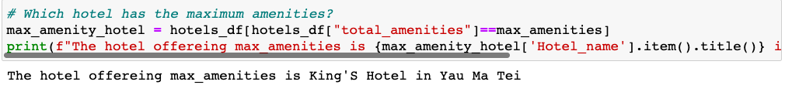

Slide 7
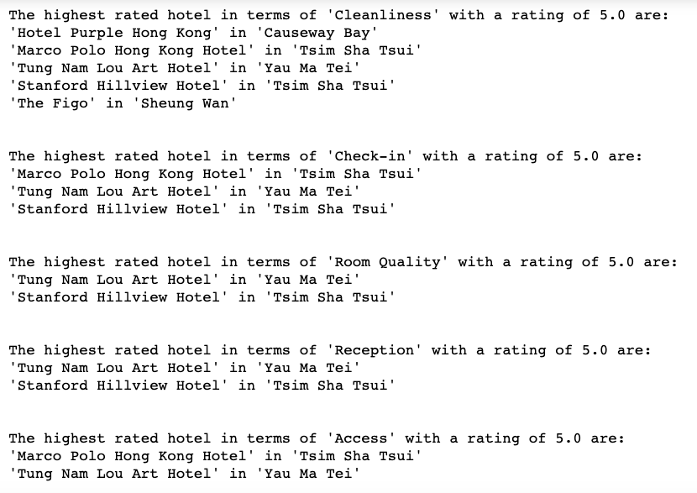

Slide 8
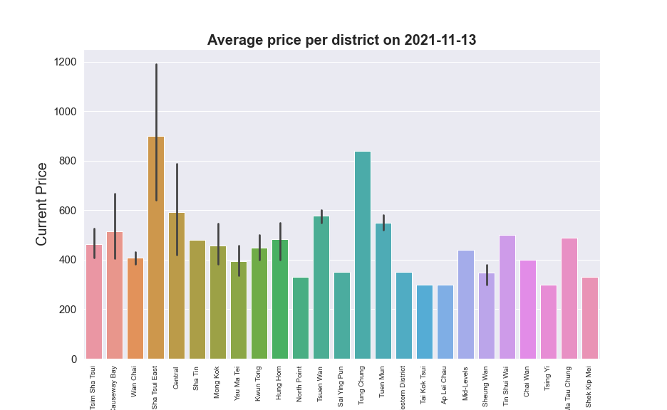

Slide 9
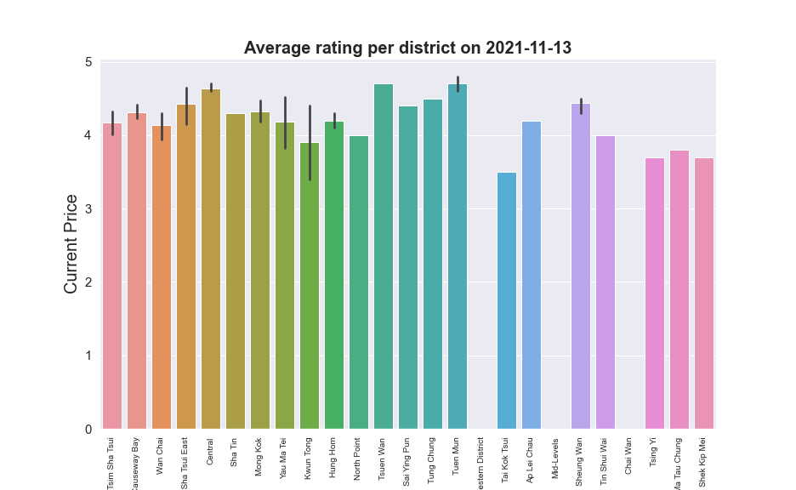

Slide 10
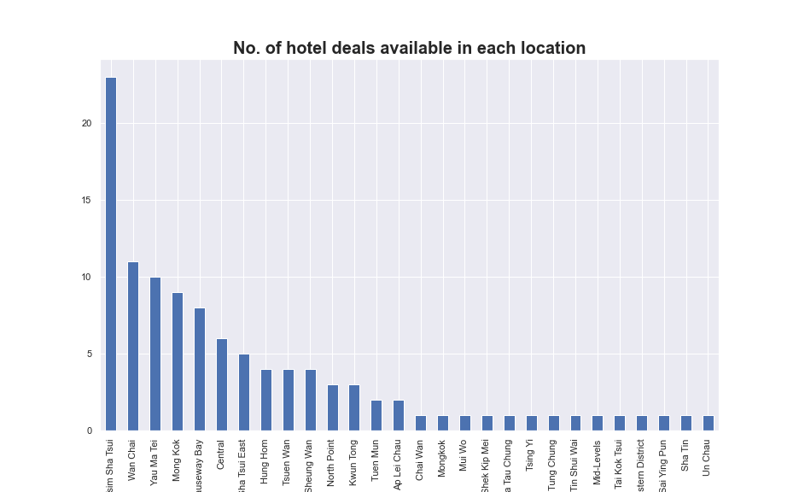

Slide 11
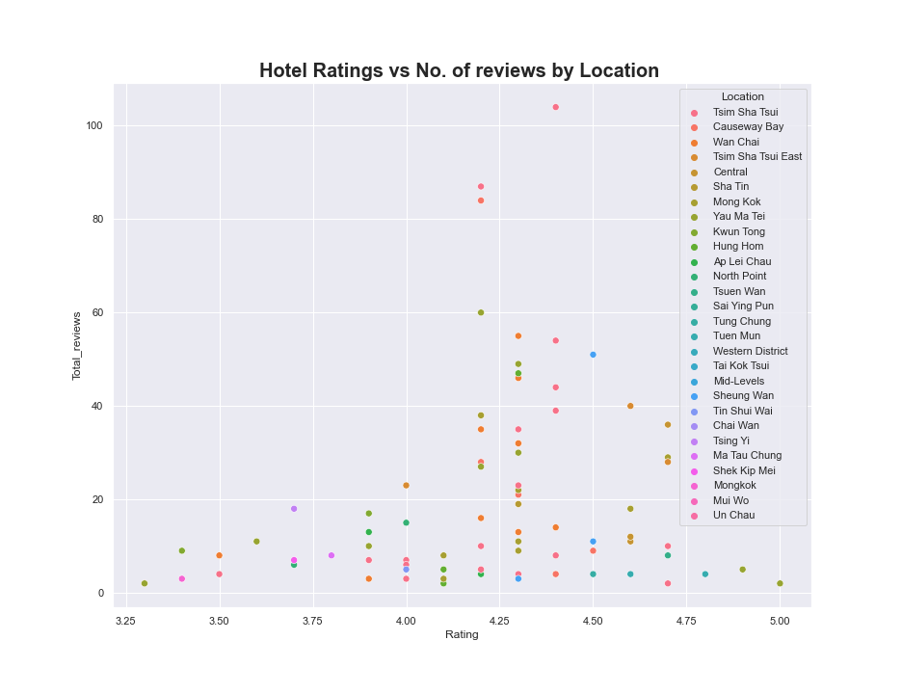
We have to be careful in our analysis as noted here that the highest rated also have low number of reviews. In order to select our relevant competitors we have to check the hotels which are highest rated as well as offer high number of reviews indicating good feedback.

Slide 12
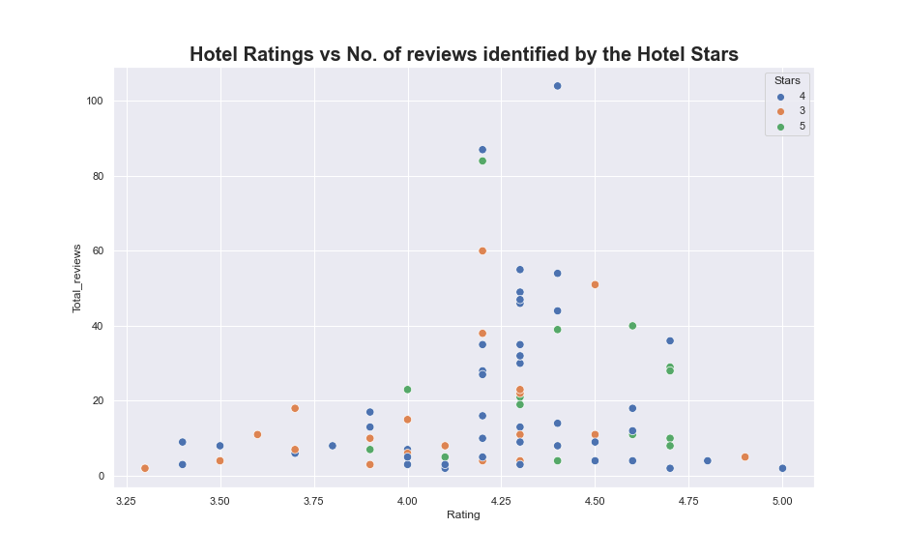

Slide 13
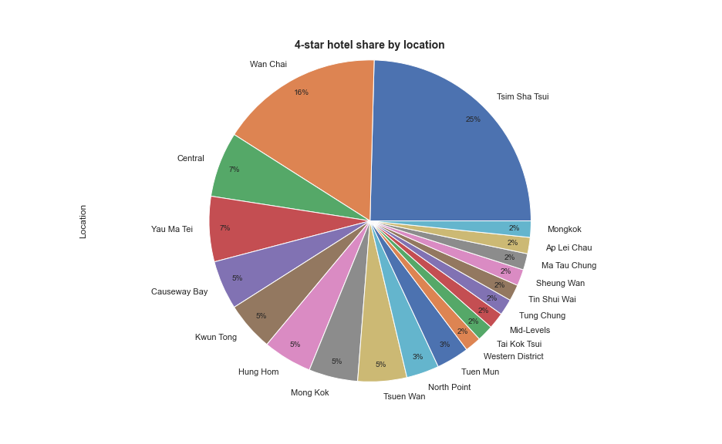

Slide 14
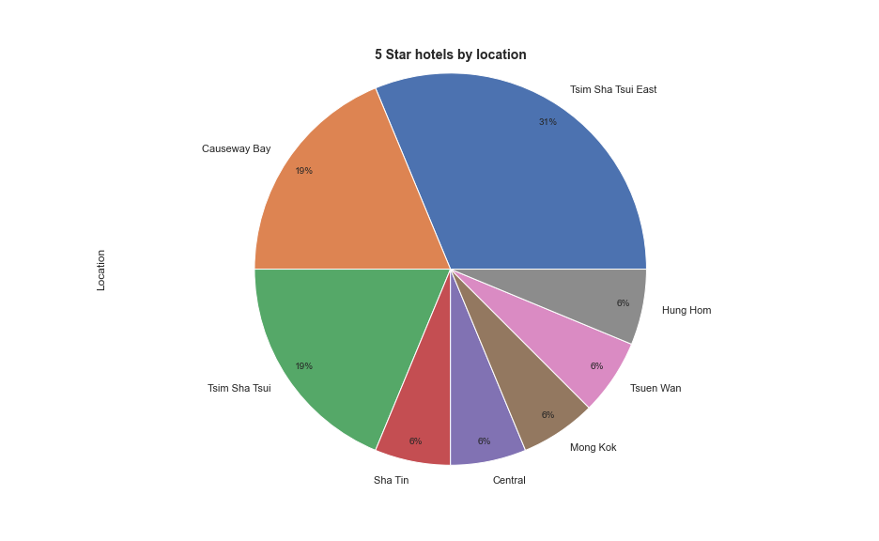

Slide 15
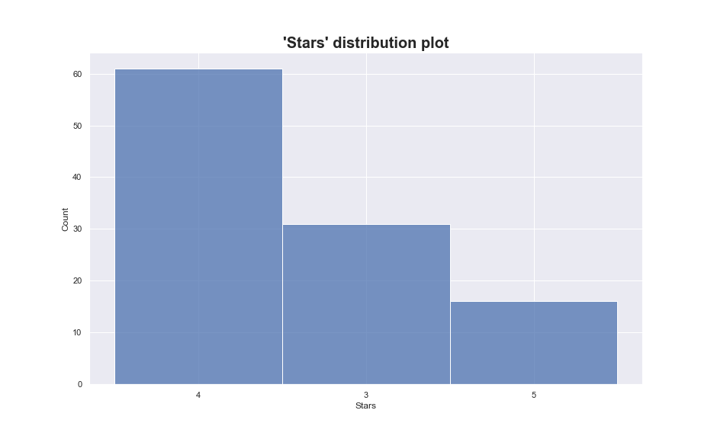

Slide 16
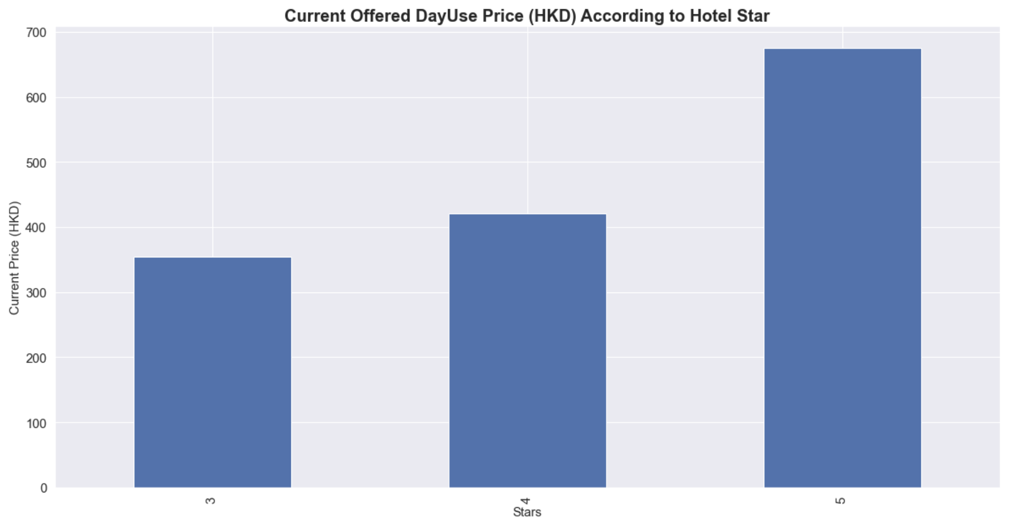

Slide 17
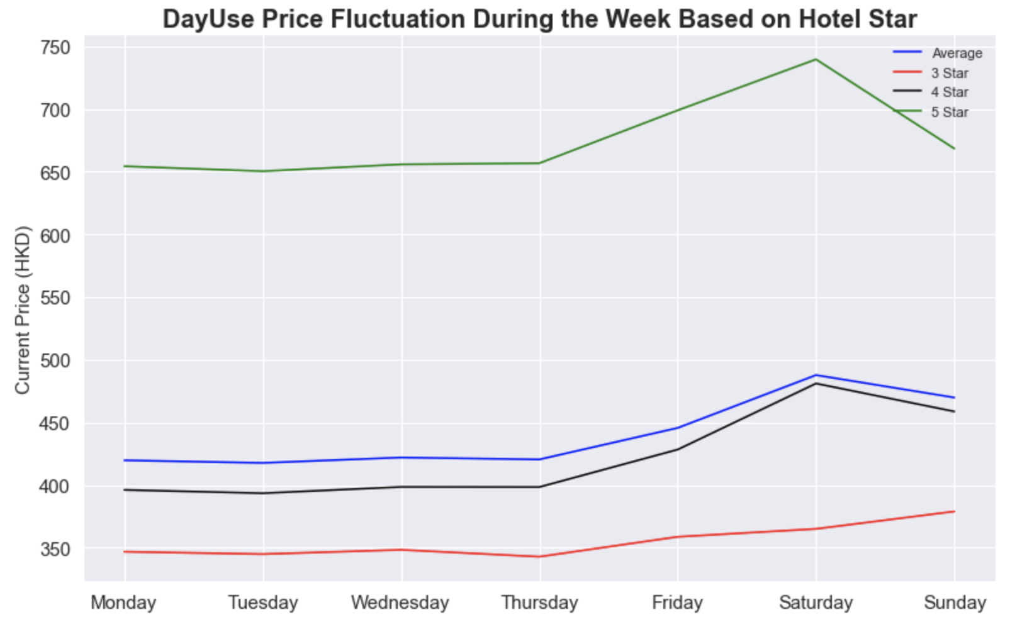

Slide 18
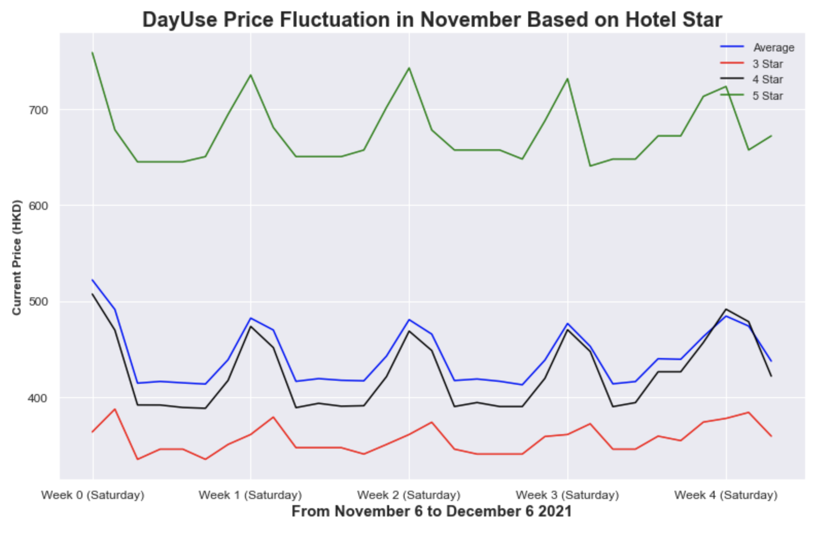

Slide 19
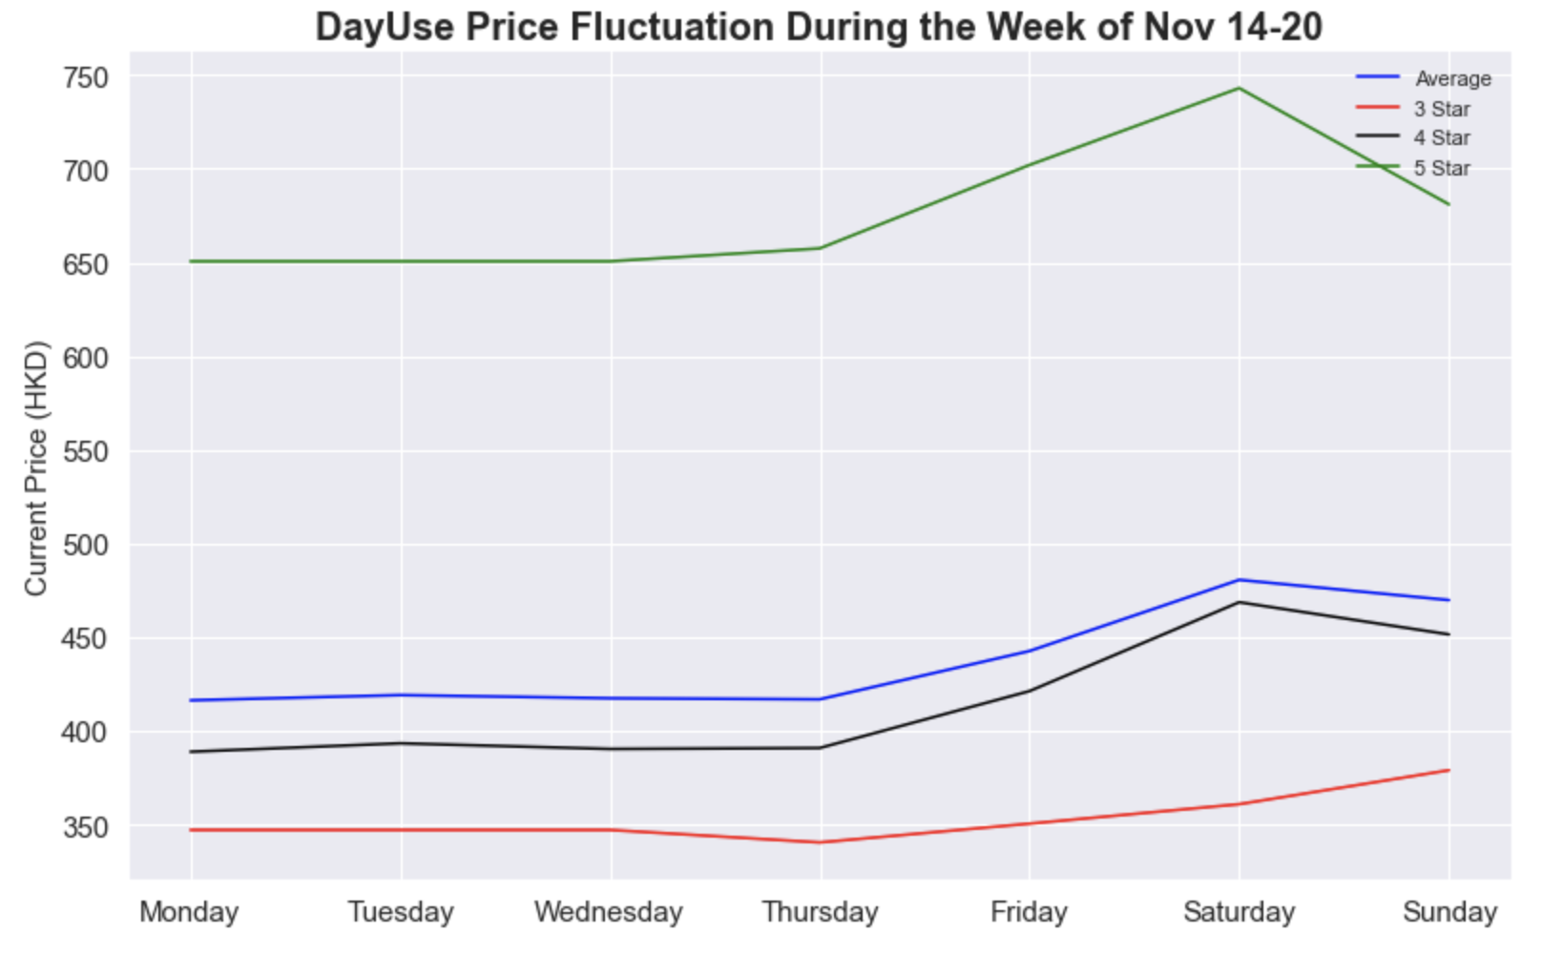

Slide 20
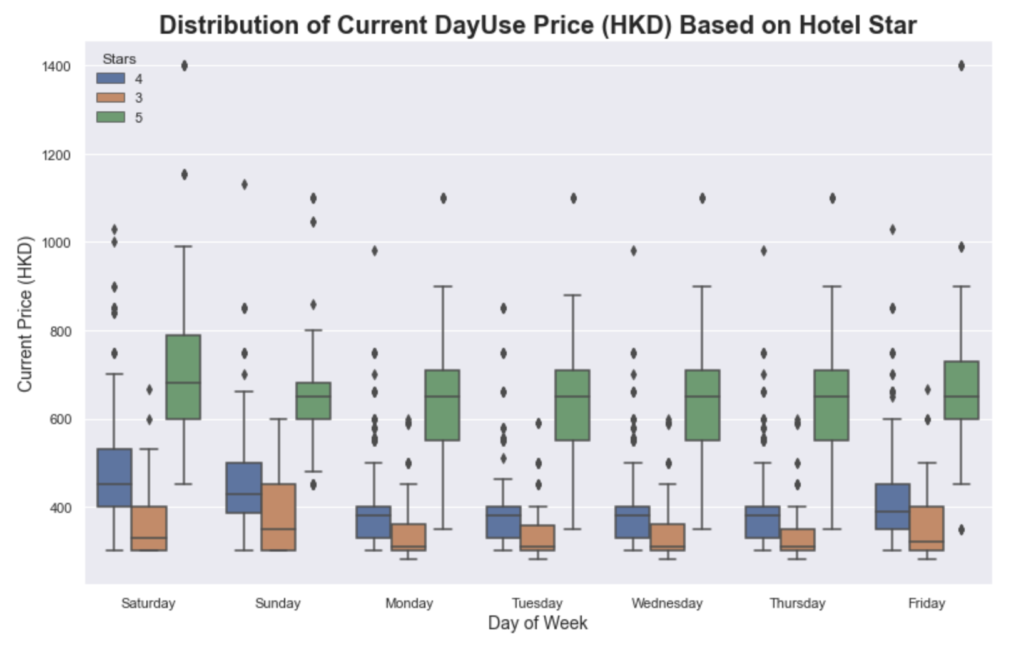

Slide 21
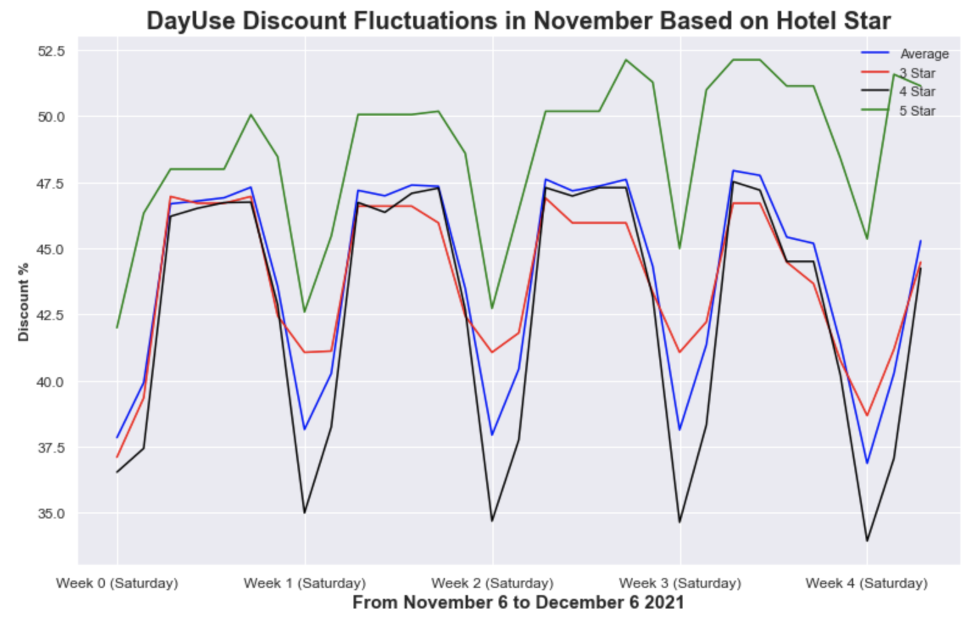

Slide 22
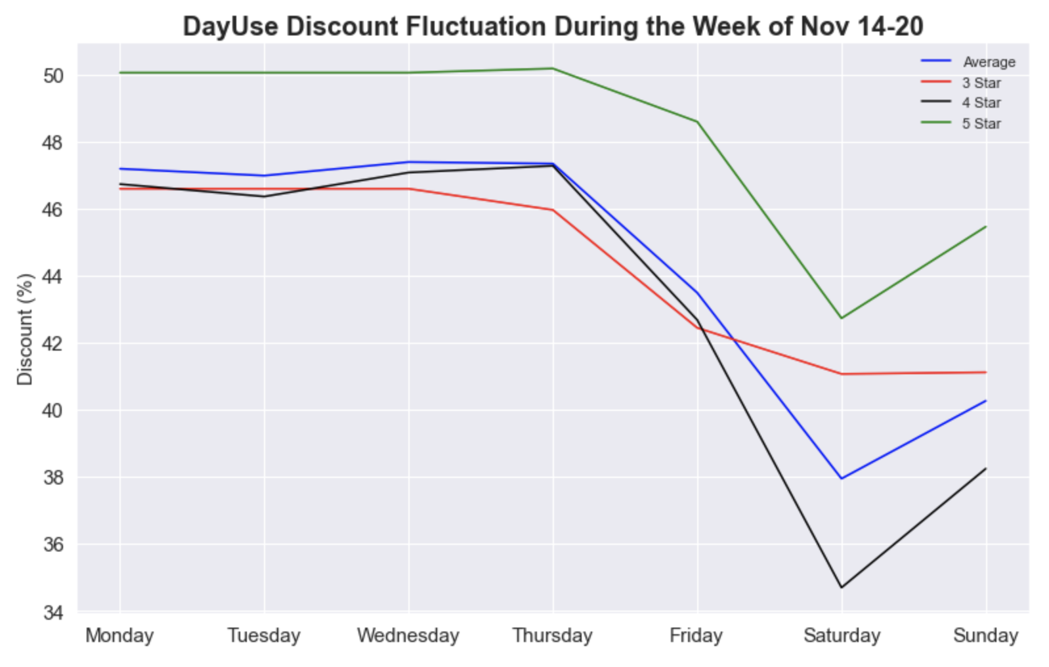

Slide 23
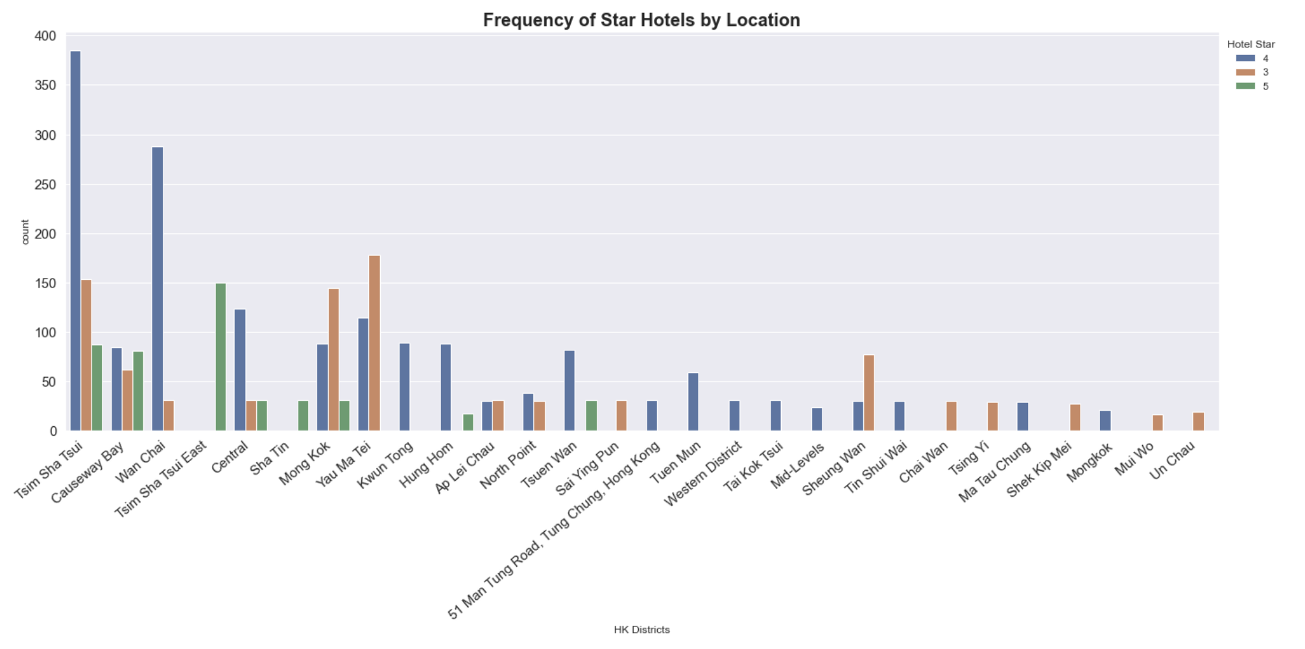

Slide 24
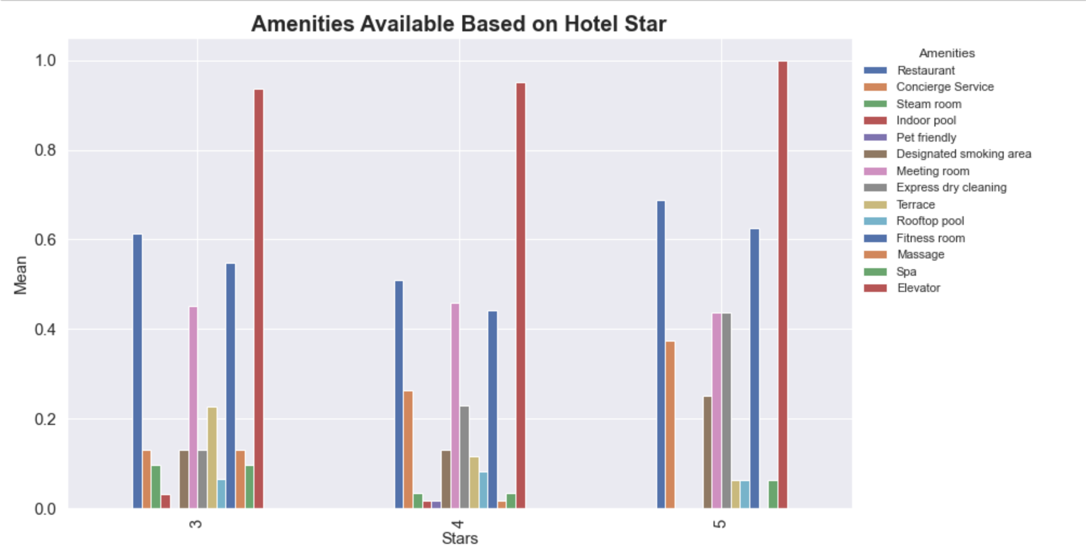

Slide 25
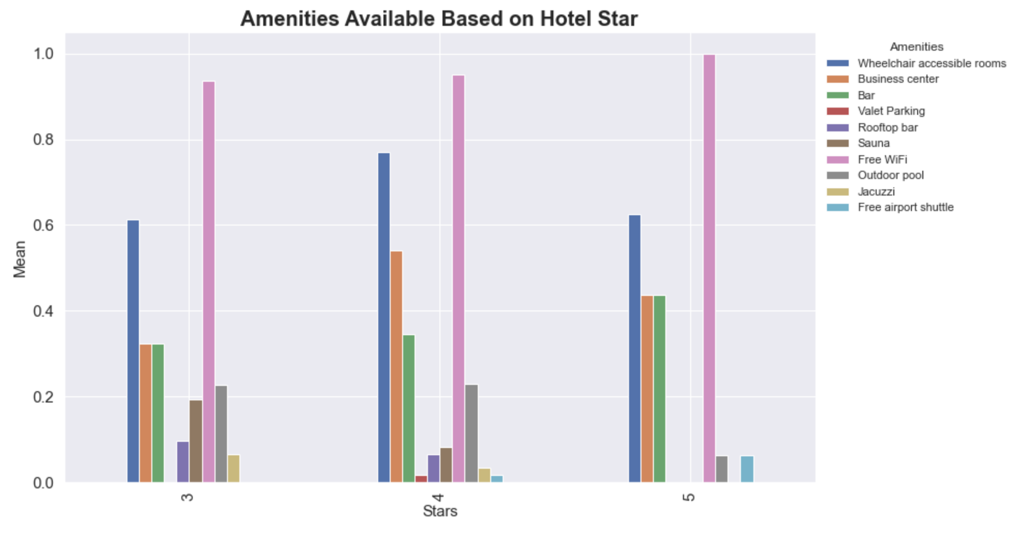

Slide 26
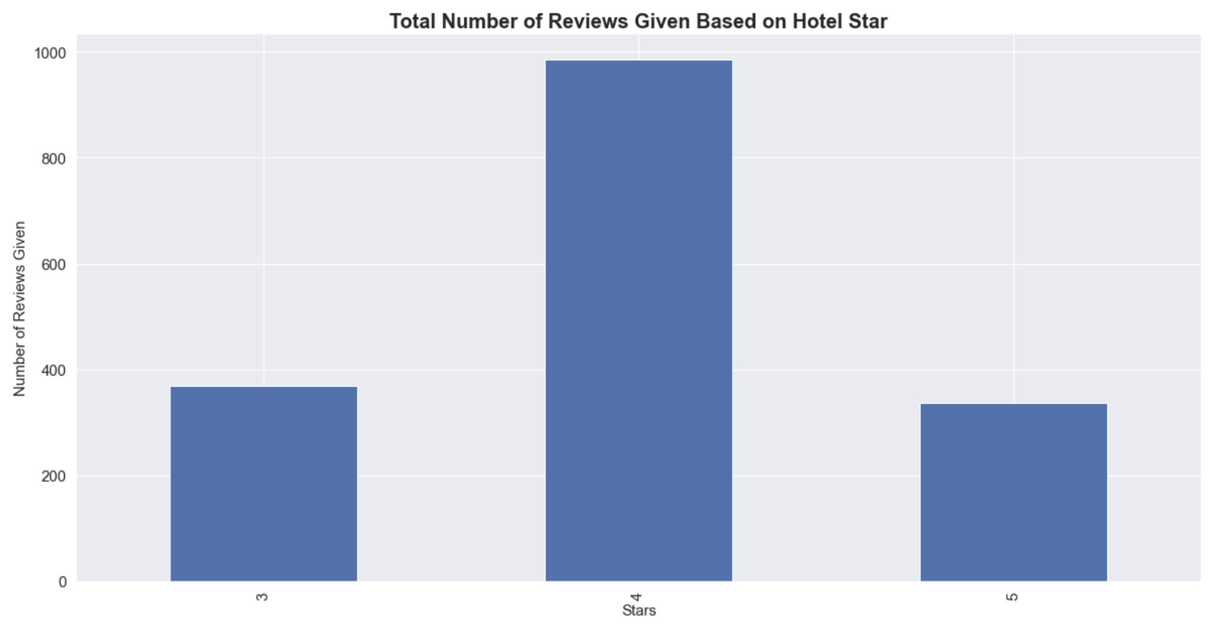

Slide 27
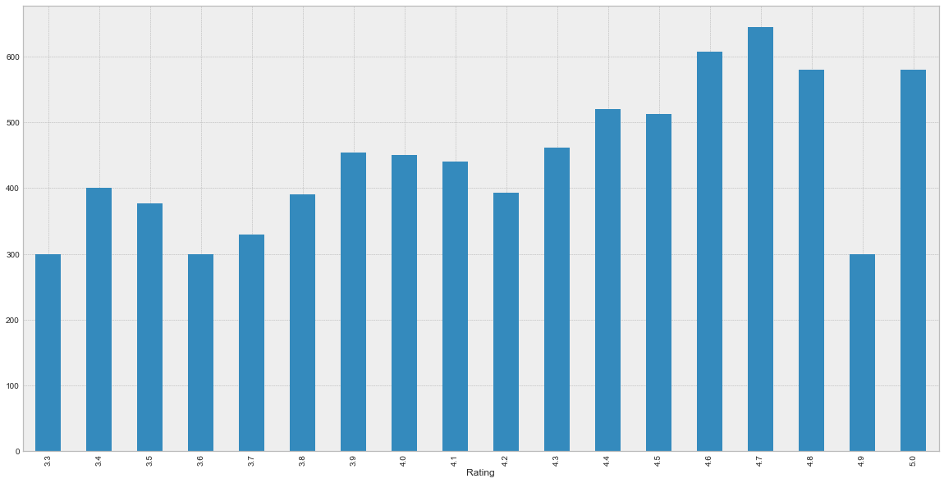
Rating vs. Current Price

Slide 28
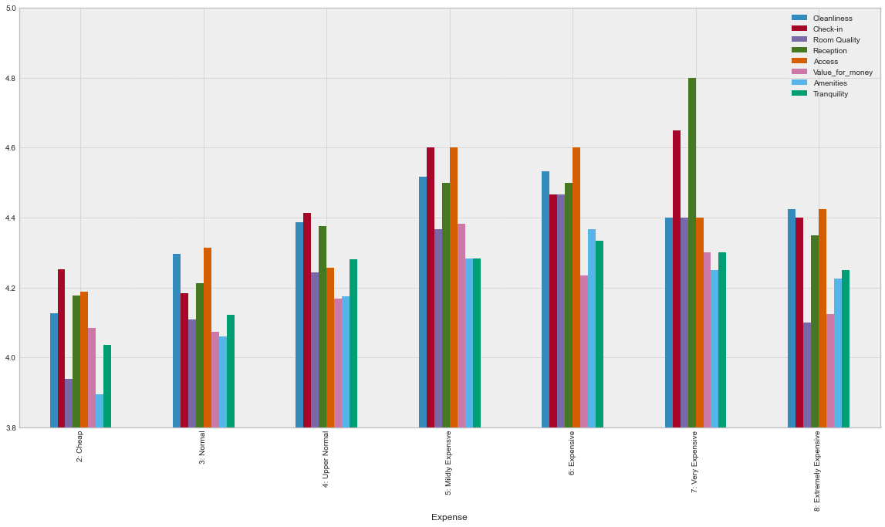
Expense vs Sub-reviews

Slide 29
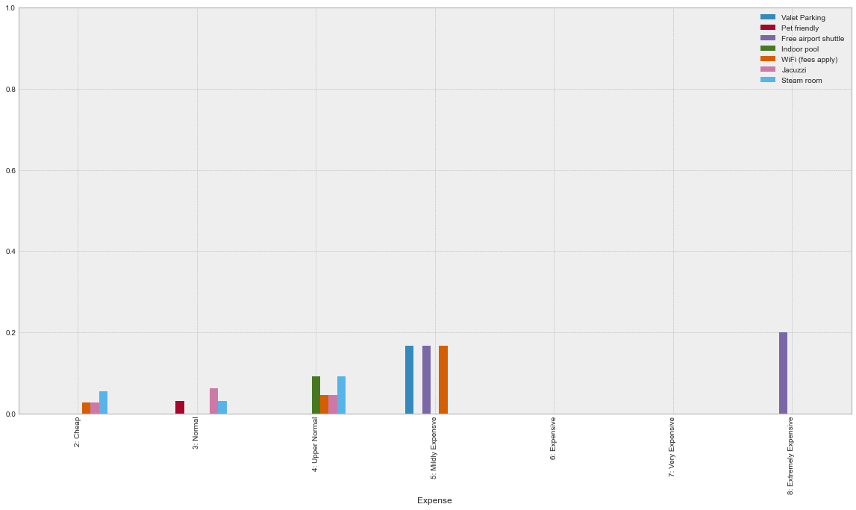
Expense vs Amenities

Slide 30
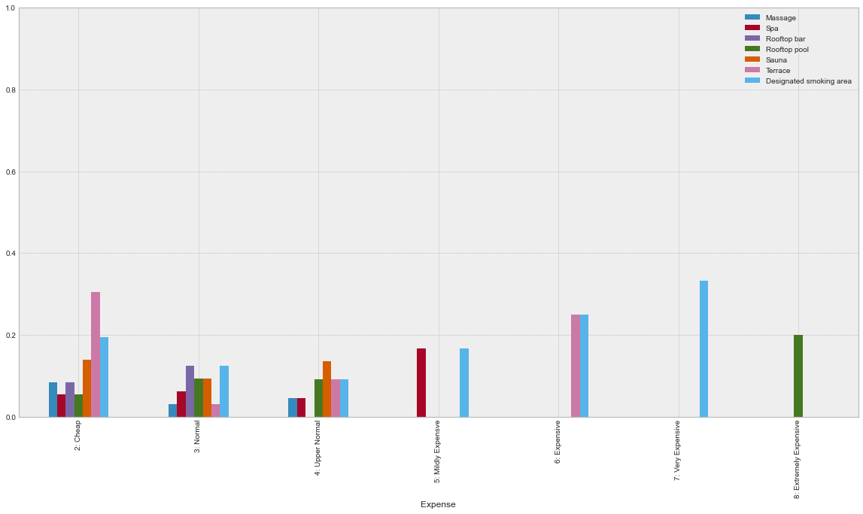
Expense vs Amenities pt. 2

Slide 31
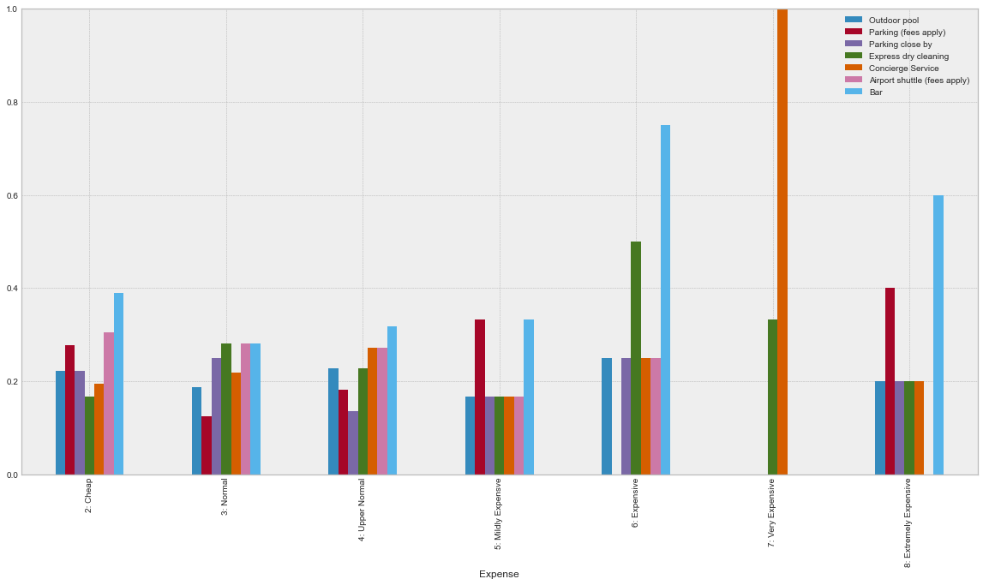
Expense vs Amenities pt. 3

Slide 32
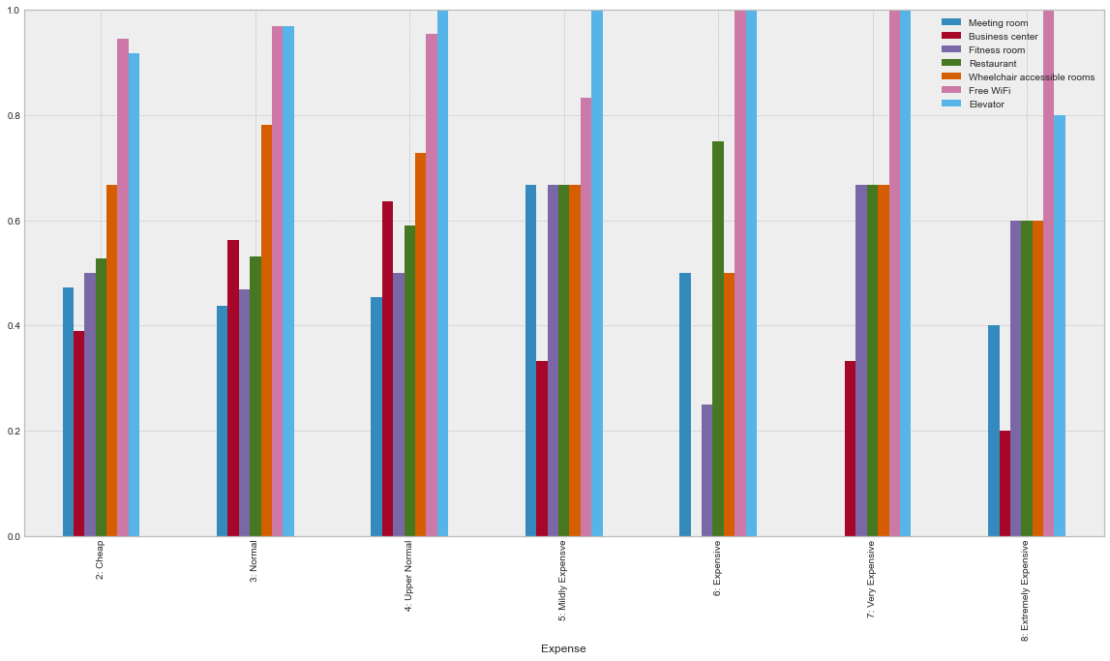
Expense vs Amenities pt. 4

Slide 33
Challenges and Next Steps
Scrape Reviews to get deeper sentiment analysis for individual hotels to get market competitive advantage.
Scrape data for multiple dates.
Also access staycation offers to increase the data frame
Analyse and review prices based on month, seasonal changes, etc.
Adjust prices based on demand and competition.

Slide 34
Conclusion
Beneficial for Hospitality and Tourism industry
If you are planning to open a hotel in a particular district, it is good to gauge the market share/price value/ratings, etc.

Slide 35
QUESTIONS?

